Slide 1
CONTEMPORARY VOICES
An Encounter

Slide 2
Read the quotes on your handout.
DO NOT SKIM
For each quote, write:
What do you feel? Name it. Disgust, recognition, confusion, agreement, nothing?
Who do you think said this? Politician, activist, country, era?
Would you share this quote approvingly, hide it, or strongly disagree? Why?
After reading all 9 quotes, look for patterns:
Which quotes feel like they "go together"?
Which one doesn't fit?
Which speaker would you most want to meet? Least?
Keep this document.

Slide 3
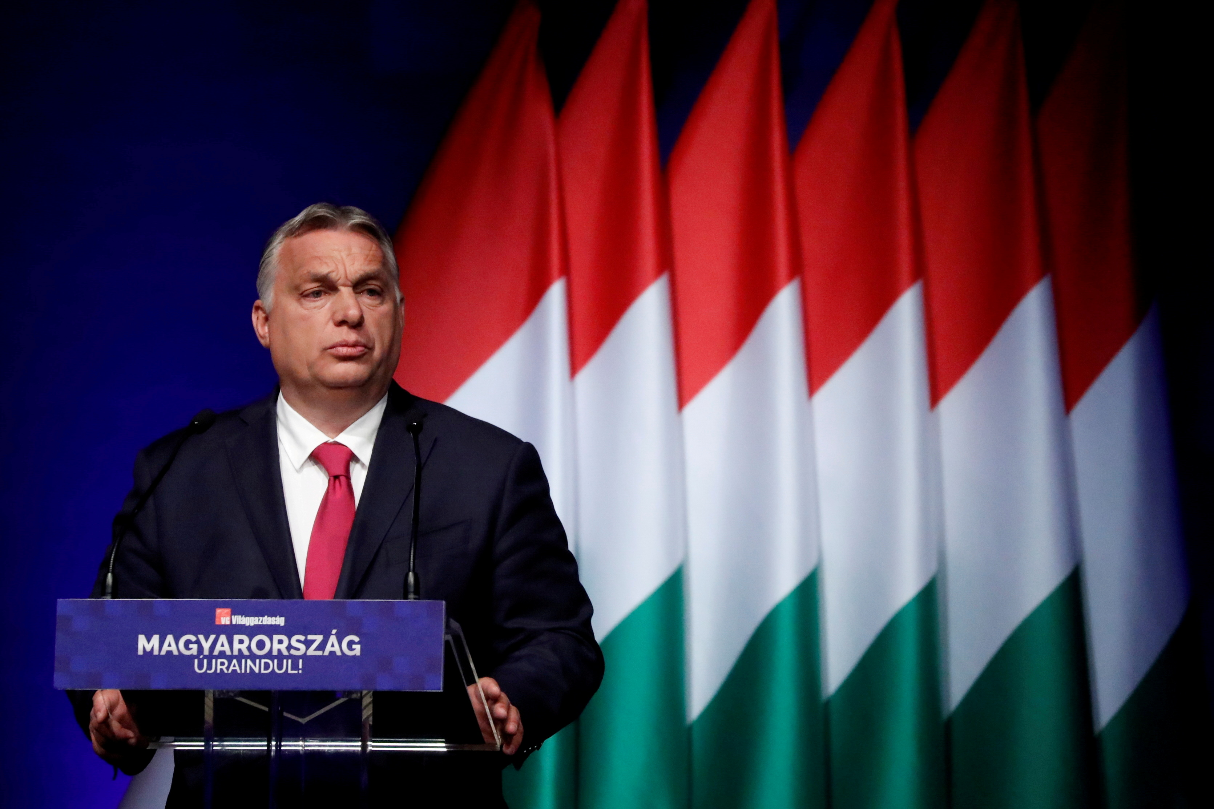
Quote 1
"We [Hungarians] are not a mixed race, and we do not want to become a mixed race."
Viktor Orbán
Prime Minister of Hungary
Speech at Băile Tușnad, Romania, July 23, 2022
CONTEXT
Historical fact: Ethnic Hungarians are a mix of Finno-Ugric Magyars and assimilated Turkic, Slavic, and Germanic peoples
(Encyclopedia Britannica). His own advisor of 20 years resigned over this speech, calling it "pure Nazi text worthy of Goebbels.“
Consider: Why would "purity" appeal to people who know their own ancestry is mixed? What does it offer?

Slide 4
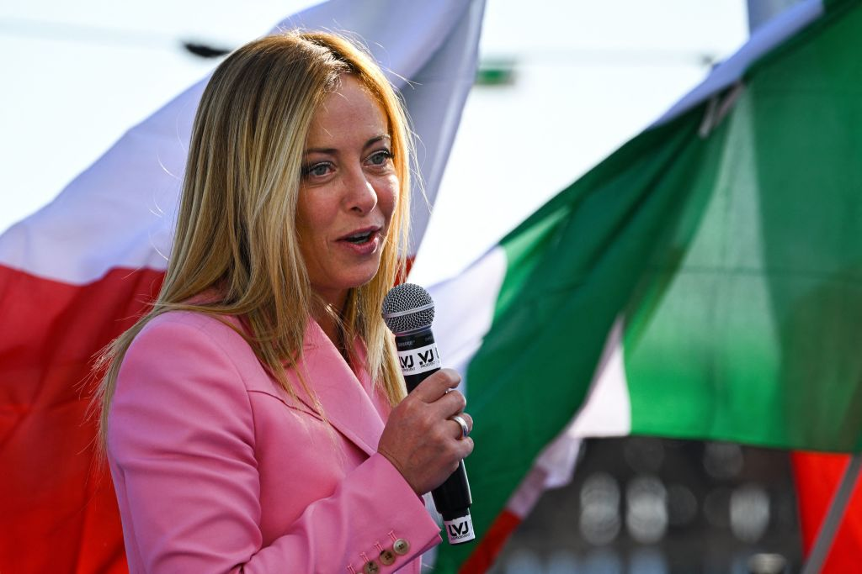
Quote 2
"There is a plan for ethnic substitution of European citizens, desired by big capital and international speculators."
"Yes to natural families, no to the LGBT lobby! Yes to sexual identity, no to gender ideology! Yes to the culture of life, no to the abyss of death!"
Giorgia Meloni
Prime Minister of Italy
Various speeches, 2019-2022
CONTEXT
"Ethnic substitution" is a rebranding of the "Great Replacement" conspiracy theory promoted by the Christchurch shooter.
"International speculators" refers to George Soros, an antisemitic trope. Her party, Fratelli d'Italia, descends from a party
founded by Mussolini's supporters in 1946.
Consider: Why do anti-immigration and anti-LGBT show up in the same politician? What connects "ethnic substitution" to
"the abyss of death"?

Slide 5
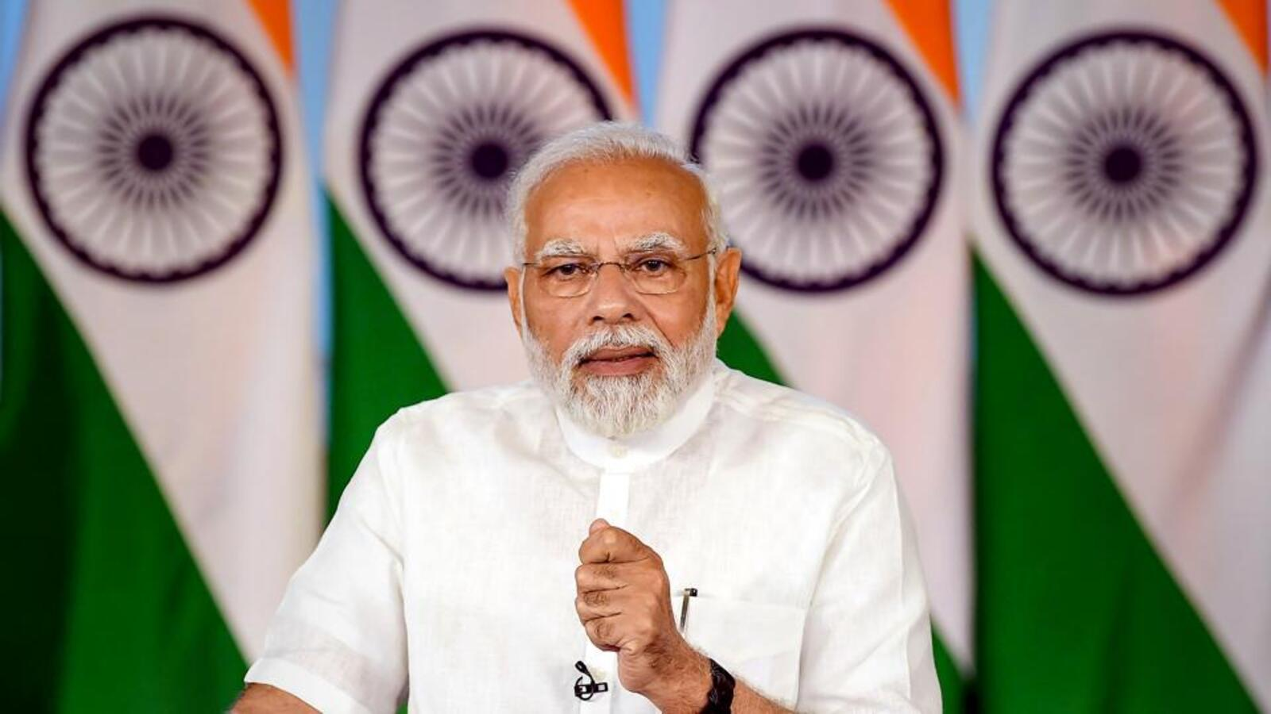
Quote 3
"They will redistribute your wealth to those who have more children. They will calculate how much gold your mothers and sisters have, to give it to the infiltrators. I guarantee: as long as I am alive, I will not let this happen."
Narendra Modi
Prime Minister of India
Election campaign rally, April 2024
CONTEXT
"Infiltrators" and "those who have more children" are terms Modi uses to refer to Muslims. India's Muslim population
is approximately 200 million people. This speech came weeks before an election in which Modi's party sought Hindu
nationalist votes.
Consider: How does "protecting mothers and sisters" become justification for targeting others?

Slide 6
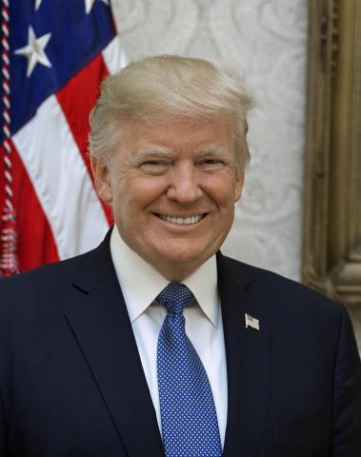
Quote 4
"They let, I think the real number is 15, 16 million people into our country. When they do that, we got a lot of work to do. They're poisoning the blood of our country. That's what they've done. They're coming into our country from Africa, from Asia, all over the world."
Donald Trump
Former and Current President of the United States
Campaign rally, Durham, NH, December 16, 2023
CONTEXT
"Poisoning the blood" directly echoes Adolf Hitler's Mein Kampf: "All great cultures of the past perished only
because the originally creative race died out from blood poisoning." When asked about the parallel, Trump said
he had never read Mein Kampf.
Consider: Why "poisoning the blood" instead of "taking jobs" or "breaking laws"? What does the biological metaphor do?

Slide 7
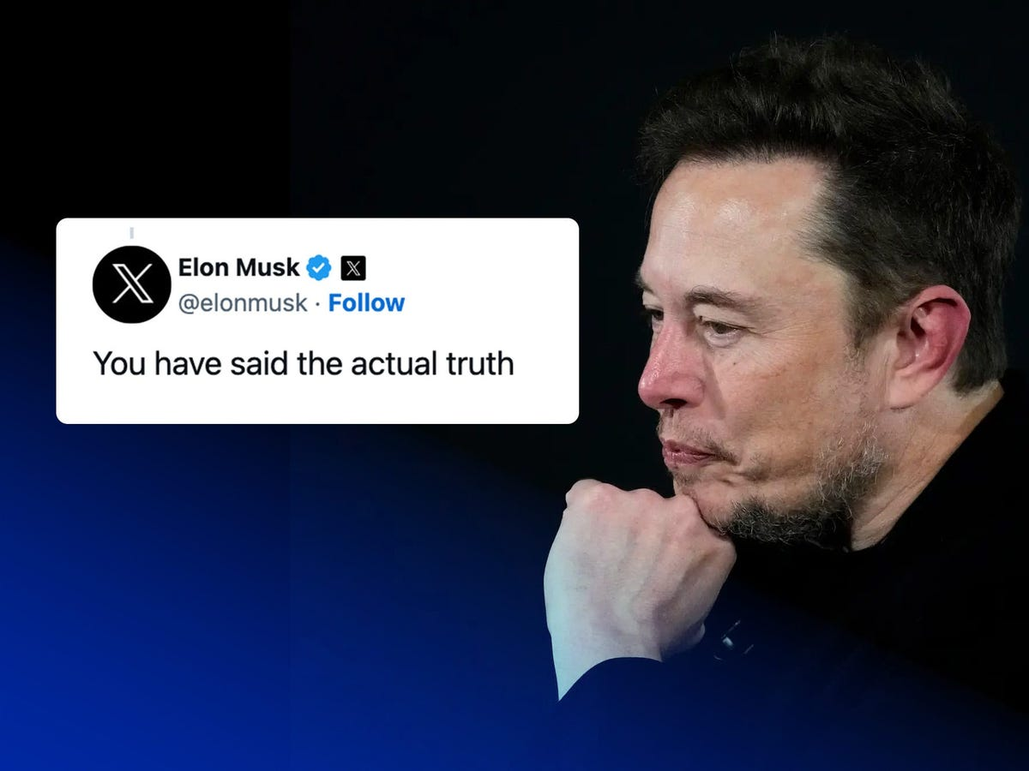
Quote 5
"You have said the actual truth."
Elon Musk
CEO of Tesla and SpaceX, Owner of X
Post on X, November 15, 2023
CONTEXT
Musk was responding to a post claiming that Jewish communities "have been pushing the exact kind of dialectical hatred
against whites" and support "hordes of minorities" flooding Western countries. The White House called his endorsement
"an abhorrent promotion of antisemitic and racist hate.“
Consider: What can the richest man in the world say that you can't? What does owning the platform change?

Slide 8
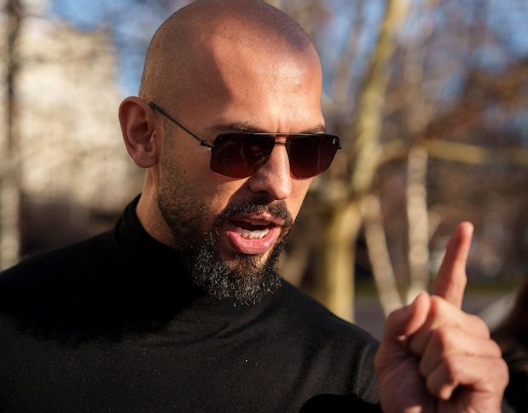
Quote 6
"I'm not saying women are property. I am saying they are given to the man and belong to the man. The Bible says it. Everything says it. It's not my opinion. It's the way the world has been for thousands of years."
Andrew Tate
Social Media Influencer
Podcast interview, 2022
CONTEXT
Tate was the most Googled person in the world in 2023. He is currently facing criminal charges in Romania including human
trafficking and rape. His content has been viewed billions of times, primarily by teenage boys.
Consider: What problem is he claiming to solve? For whom? What's the appeal?

Slide 9

Quote 7
[Laughing] "We came, we saw, he died."
Hillary Clinton
U.S. Secretary of State
CBS interview on the death of Muammar Gaddafi, October 2011
CONTEXT
Clinton had just learned of Libya’s leader Muammar Gaddafi's death. The phrase echoes Julius Caesar's "Veni, vidi, vici"
("I came, I saw, I conquered"), reportedly written to the Roman Senate after a swift military victory in 47 BC. The NATO
intervention was justified as protecting civilians during the Arab Spring. At the time of his death, Libya had the highest
Human Development Index in Africa. Gaddafi had recently proposed a gold-backed African currency to rival the dollar.
Following the intervention, Libya collapsed into civil war; open-air slave markets have since been documented in the country.
Consider: Can you laugh at liberation? What kind of victory gets celebrated this way?

Slide 10
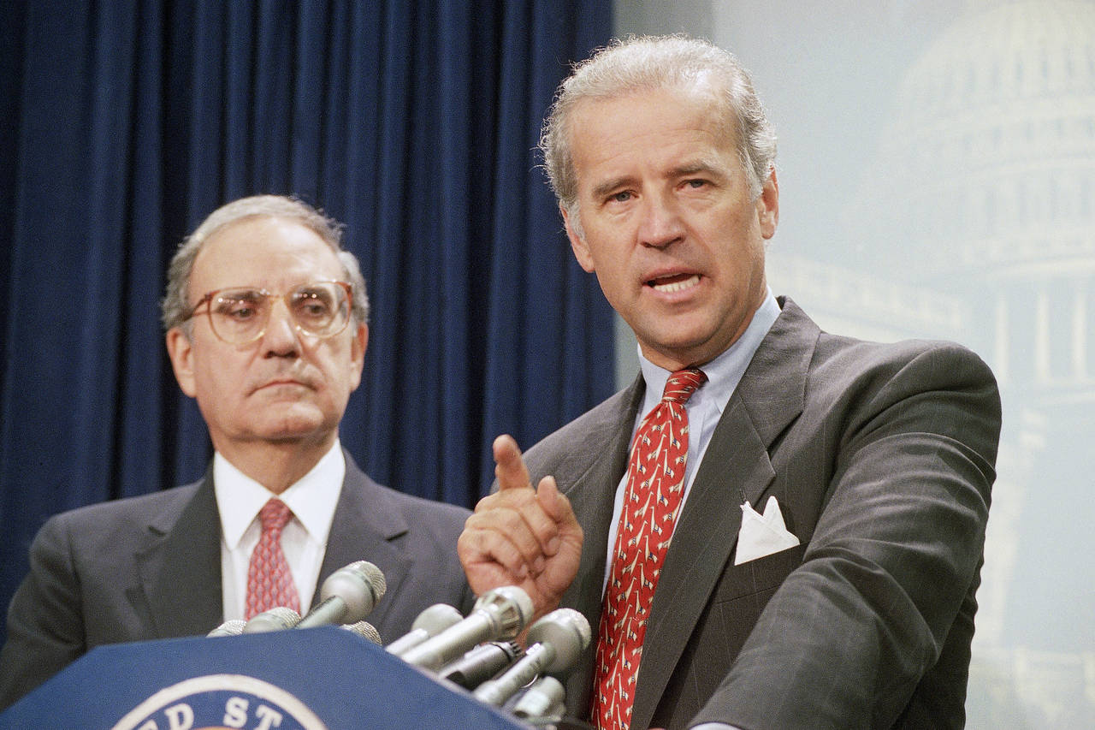
Quote 8
"I agree with the Israeli position on this. If we have evidence that they are building a missile defense, a missile system, an offensive system with a nuclear capacity and they will not negotiate with us, I would support a unilateral strike to take them out. That to me is a hell of a lot less risky way to deal with my grandchildren's future than to engage in an overall arms race."
Joe Biden
U.S. Senator (D-Delaware), Member of Judiciary Committee
Speech at American Jewish Committee event, C-SPAN Campaign 2000 coverage
CONTEXT
Biden is discussing North Korea's nuclear program. This is not a response to an attack or even a direct threat, but to the
possibility of development. North Korea's population at the time was approximately 22 million people. The United States’
nuclear stockpile in 2000 was approximately 10,000 warheads. Consider: who decides which countries are allowed to
have nuclear weapons? Who should decide?
Consider: He's protecting his grandchildren. What about theirs?

Slide 11
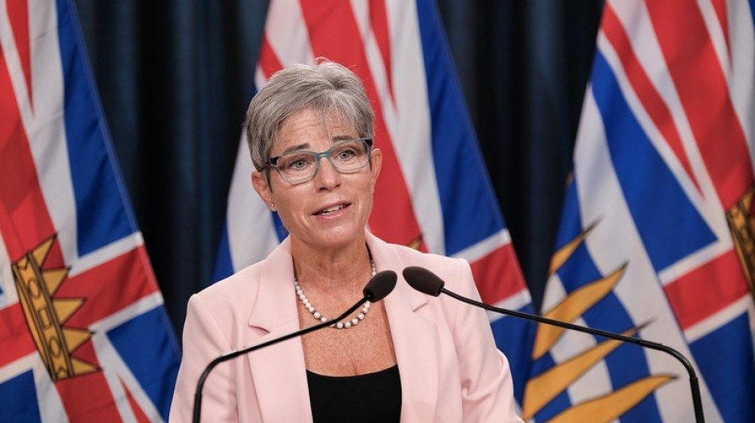
Quote 9
"The truth is, [Palestine] was a crappy piece of land with nothing on it. It was a place that hadn't really figured out quite what they were going to do with themselves. So when the opportunity came to take it, of course they took it."
Selina Robinson
BC Minister of Post-Secondary Education
B'nai Brith Canada panel on Palestine, January 30, 2024
CONTEXT
This is the doctrine of terra nullius ("nobody's land"), used to justify colonization worldwide. Palestine had a population of
approximately 700,000 in 1914. Robinson resigned from cabinet after these remarks. She remained an MLA but later chose
not to seek re-election.
Consider: What do you have to say about people before you can take what's theirs?

Slide 12
Keep this handout.
We will return to it.

